Slide 1
4th lecture: Complementary and alternative medicine (CAM)
(CAM) refers to:
a group of medical and health-care systems, practices & products that are not considered to be part of conventional medicine;

Slide 2
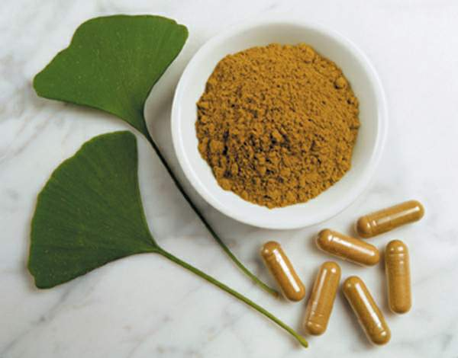
Complementary & alternative medicine (CAM)
Gingobilobia

Slide 3
Protocol Of The Lectures
Epidemiology
The Uses Of CAM
Definitions of CAM
Type Of CAM
Recent Advance, Evidence
Popularity
Safety
Big Five Type Of CAM
Details Of Some Type CAM

Slide 4
Epidemiology
Some forms of CAM are embedded in the cultural norms of particular social and ethnic groups, e.g. traditional Chinese medicine
In Western society, the use of CAM is extensive.
For example, in 2007 in the USA, 38% of the adult population had used some form of CAM in the previous year
(males 33.5%, females 42.8%);
12% of children had also used CAM.

Slide 5
most common medical conditions
need CAM, were involved :
back pain, neck pain, ,joint pain/arthritis
Anxiety
raised cholesterol, head or chest ‘colds’
Headache
insomnia
stress and depression
gastrointestinal symptoms

Slide 6
CAM
CAM covers an enormous and ever-changing range of activities, from well established physical therapies such as osteopathy to spiritual measures such as prayer specifically for health.
Proponents suggest that CAM focuses on the whole person:
their lifestyle
environment
diet
mental
Emotional and
spiritual health, as well as physical complaints

Slide 7
definitions
‘Complementary medicine’ is the term used to describe the use of these treatments in conjunction with conventional medicine (e.g. acupuncture to reduce pain after surgery).
‘Alternative medicine’ describes their use in place of conventional medicine (e.g. reflexology instead of anti-inflammatory drugs for arthritis).
Clearly, most forms of treatment can be used in either way, so the term CAM is often used generically.
‘Integrative medicine’ describes the use of conventional therapy in combination with one or more complementary therapies.

Slide 8
The National Center for Complementary and Alternative Medicine in the USA uses the following classification: taxonomies
Alternative medical systems.
Mind–body interactions.
Biologically based therapies
Manipulative and body-based methods
Energy therapies
Some forms of CAM ( embedded) in the cultural norms

Slide 9
Alternative medical systems.
These have their own constructs of theory and practice, often based on ancient historical beliefs.
Examples are :
homeopathy,( coffee for insomnia)
naturopathy, ( body healing power)
traditional Chinese medicine and
Ayurveda.(harmony and balance )

Slide 10
Mind–body interactions.
Mind–body interactions: These rely on the mind’s capacity to influence physical function. Examples are:
meditation, ( person attention )
biofeedback, ( consciously regulate body function )
prayer for healing
mental healing
music therapy and
dance

Slide 11
mind–body medicine
Some evidence supports the role of such practices in the treatment of:
asthma,
coronary artery disease
Cancer
osteoarthritic pain
low back pain
chronic headache
smoking cessation

Slide 12
Other type
• Biologically based therapies: These involve the use or regulation of an extraneous agent or preparation include:
herbal medicine
dietary supplementation
nutritional medicine
• Manipulative and body-based methods: These are based on manipulation or movement of parts of the body. They include:
osteopathy
chiropractic, ( mapulation,adjesment )
reflexology (rub ), and
massage

Slide 13
Other Therapy
• Energy therapies: These involve use of energy fields. Examples include :
qigong, (gentle physical movement) in ancient chines
Reiki: ( life force energy from therapist to patient ) Reduce:
stress,
pain, and
fatigue
therapeutic touch ( finger tip)
Some forms of CAM: are embedded in the cultural norms of particular social and ethnic groups, e.g.:
traditional Chinese medicine.

Slide 14
Herbal therapy
defined as:
products other than vitamins and minerals taken by mouth and containing dietary ingredients intended to supplement the diet. E.g.
Glucosamine chondroitin for Osteoarthritis
St. John's wort for Depression
Ginkgo biloba for Dementia
Phyto-estrogens for Menopausal symptoms
Saw palmetto for Benign prostatic hyperplasia
Echinacea for Upper respiratory tract infection

Slide 15
Safety of CAM
Not all CAM therapies are safe;
Some are toxic in their own right (e.g. dietary supplements containing ephedrine alkaloids, now banned in USA)
Others are harmful if used in combination with conventional treatment (e.g. garlic supplements that interfere with the action of anti-HIV chemotherapy)
Others have been associated with rare but serious side-effects, which can be life-threatening (e.g. bowel perforation from coffee enemas, hyponatraemia from noni juice).

Slide 16
potential for harm
Potential for harm when CAM is used to treat serious or life-threatening medical conditions, if the resultant delay in seeking conventional treatment compromises clinical outcome.
On balance, however, the relative safety of most CAM therapies can be regarded as a positive feature; homeopathy is an example.

Slide 17
The popularity of CAM
may reflect the:
lack of confidence in conventional medicine, particularly a belief that it will not help the condition or may cause harm
often used by cancer patients who have disease which is unresponsive to conventional medicines.
increasing ease of access to information &therapies via the Internet.
CAM is often seeming to be completely safe; patients may therefore be willing to experiment with it as a ‘no-lose’ measure.
inherently pleasurable, Many forms of CAM regardless of any therapeutic benefit

Slide 18
Quiz
Q: enumerate the types of environmental hazard for the health.

Slide 19
Quiz
Q: define the biological hazard, give an example for each type

Slide 20
مسح لرأي الجهة المستفيدة (طلبة المرحلة الأولى)
أجب عن التالي:
1. ما هورأيك الصريح بالمحاضرات من الأولى الى نهاية محاضرة اليوم
2. من أكثر المحاضرات نالت أعجابك
3.هل انت راضٍ عن طريقة أعطاء المحاضرات

